Slide 1

Introduction
and
Overview
Week 1
19 January 2022

Slide 2


Slide 3
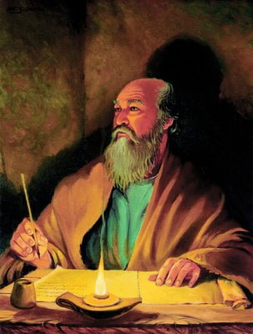
The Apostle Paul at his writing desk

Slide 4
NEW TESTAMENT
GOSPELS
Galatians
Galatians
Hebrews
Matthew
Ephesians
GENERAL EPISTLES
Ephesians
Philippians
Mark
Philippians
James
Luke
Colossians
Colossians
1 Peter
John
1 Thessalonians
2 Peter
Acts
2 Thessalonians
1 John
PAUL’S EPISTLES
1 Timothy
2 John
Romans
2 Timothy
3 John
Romans
1 Corinthians
Titus
Jude
1 Corinthians
2 Corinthians
Philemon
REVELATION
Notes:
In Slide Show mode click on any option above to be taken to the book or section of the Bible.

Slide 5
AN INTRODUCTION
and
AN OVERVIEW

Slide 6

The Pauline Epistles
First Missionary Journey:
Galatians (ad 48-49)
Second Missionary Journey:
1 Thessalonians (ad 50-52)
2 Thessalonians (ad 50-52)
Third Missionary Journey:
1 Corinthians (ad 55-56)
2 Corinthians (ad 56)
Romans (ad 57)

Slide 7
The Pauline Epistles
First Roman Imprisonment:
Ephesians (ad 60)
Philippians (ad 62)
Colossians (ad 62)
Philemon (ad 62)
While in Macedonia
1 Timothy (ad 63 – 66)
Titus (ad 63 – 66)
Second Roman Imprisonment:
2 Timothy (ad 67)
Hebrews (ad 68 – 69)

Slide 8
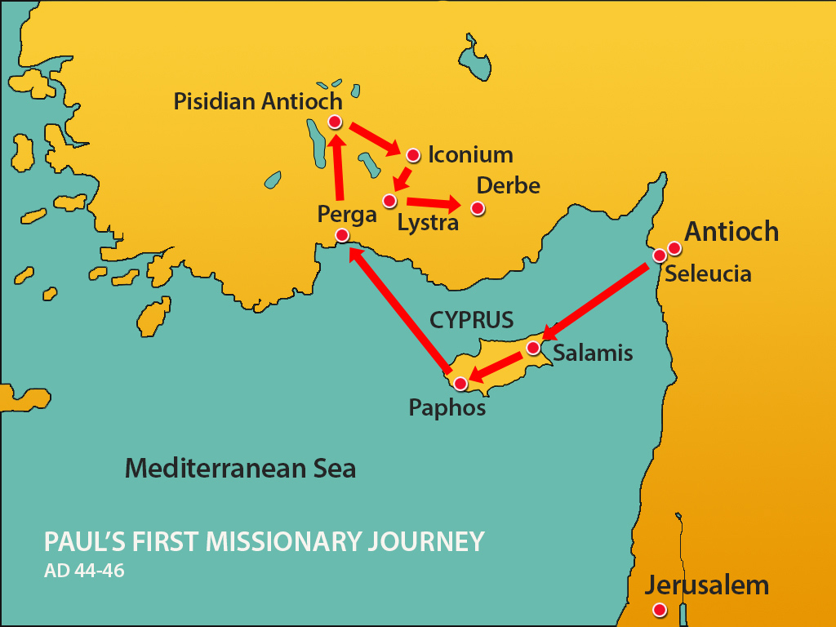

Slide 9
The Pauline Epistles
“Religions are man’s search for God; the Gospel is God’s search for man. There are many religions, but one Gospel.”
E. Stanley Jones

Slide 10


Slide 11
Galatians
Who: Paul
What: Letter to the Churches in Galatia
Where: Written from Antioch of Syria
When: c. ad 48-49 or ad 54-55
Why: To warn against legalism and defend justification by faith as well as Paul’s apostolic authority.
Synopsis: Christians are free from restrictive Jewish laws, including circumcision.

Slide 12
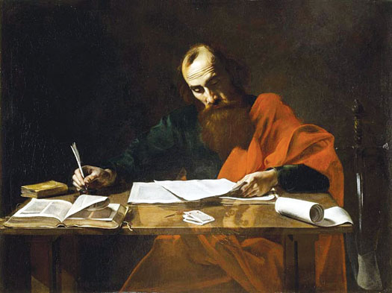
Galatians
Outline (Chapter):
Paul’s Defense (1 – 2)
Justification by Faith (3 – 4)
The Christian Life (5 – 6)
The Apostle Paul at his writing desk

Slide 13
Galatians
Overview:
Galatians, though one of Paul’s shorter epistles, is highly esteemed as one of his greatest and most influential. Since both Romans and Galatians teach the doctrine of justification by faith, the former has been considered by some to be an expansion of Galatians and the latter has been called “a short Romans.”
Like Second Corinthians, the Epistle of Galatians eloquently defends Paul’s apostolic authority and contains in summary form what the apostle taught. In particular it contains a clear statement of justification by faith and builds on that foundation a defense of Christian liberty against any form of legalism.

Slide 14
Galatians
Overview:
In the early church, as the separation between Judaism and Christianity was taking place, the letter to the Galatians no doubt helped clarify that cleavage. Centuries later it played such a key role in the Reformation that it was called “the cornerstone of the Protestant Reformation.”
This was because its emphasis on salvation by grace through faith alone was the major theme of the preaching of the Reformers. Luther was especially attached to Galatians and referred to it as his wife. He lectured on the book extensively and his Commentary on Galatians was widely read by the common people.

Slide 15
Galatians
Overview:
The churches Paul founded in the Roman province of Galatia (Acts 13-14) were invaded by false teachers like those Paul had refuted in the Jerusalem Council (Acts 15). We call these people “Judaizers” because they tried to bring Christians into bondage to the laws of Moses (Judaism).
Paul can only “marvel” (1:6) that Galatian Christians have turned from their freedom in Jesus back to the rules of Old Testament legalism. Some people tried to compel Christians “to live as do the Jews” (2:14), an error even the apostle Peter made (2:11-13). Paul argued strongly “that no man is justified by the law in the sight of God … for the just shall live by faith” (3:11).

Slide 16
Galatians
Overview:
In this letter, Paul is struggling to preserve the purity of the gospel from those who would present “another gospel” which is not another, but there be some that trouble you and would “pervert the gospel of Christ.”
Paul went to Galatia on his first missionary journey (Acts 13-14) and that he paid a second visit there during the second missionary journey. A second visit is apparently described in Acts 18:23.
The Galatians themselves were an emotional and intense people. They were a branch of the Gauls originally from the north of the Baltic Sea.

Slide 17
Galatians
Overview:
This is the only time in all of Paul’s writing in which he does not express his thankfulness. This is the only church of whom he does not ask for prayers. There is no word of commendation nor praise and there is no mention of their standing in Christ. No one with him is mentioned by name.
The heart of Paul is laid bare; there is deep emotion and strong feeling. This is Paul’s fighting epistle. Galatians is the declaration of emancipation from legalism of any type. Galatians is indeed the “Magna Charta of Christians Liberty,” proclaiming to modern generations that salvation from the penalty and power of sin comes not by works but by grace through faith in God’s provision.

Slide 18
Galatians
Overview:
Paul wrote this letter to magnify God’s grace in salvation and to explain the freedom of God’s people because of that grace. It opens with a personal affirmation (Ch 1-2) as Paul explains how God delivered him from bondage through faith in Jesus Christ.
Paul then gives a doctrinal explanation and shows the relationship between laws and grace (Ch 3-4). He closes with a practical application that tells us how to enjoy grace and freedom in our daily life (Ch 5-6).
Christian freedom is the liberty to become all that we can in Christ; it is not the license to do whatever we please.

Slide 19
Galatians
Overview:
The Spirit always produces living fruit (5:22), which is …
  Love – divine concern for others.
  Joy – inward peace.
  Peace – a confidence and quietness.
  Longsuffering – patience, endurance.
  Gentleness – kindness.
  Goodness – love in action.
  Faith – things not seen.
  Meekness – subdued strength.
  Temperance – self control.

Slide 20
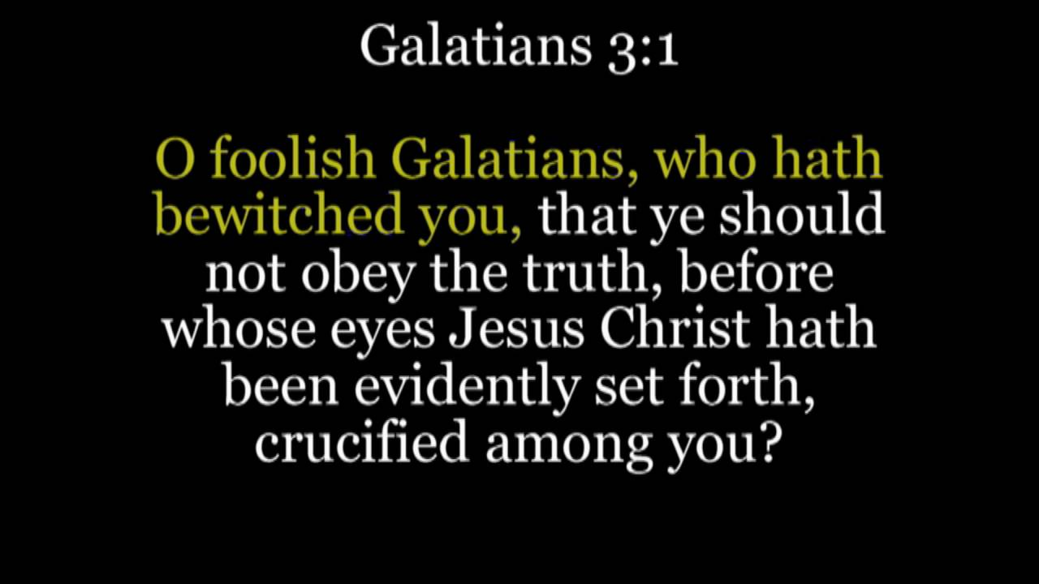
Galatians 3:1

Slide 21
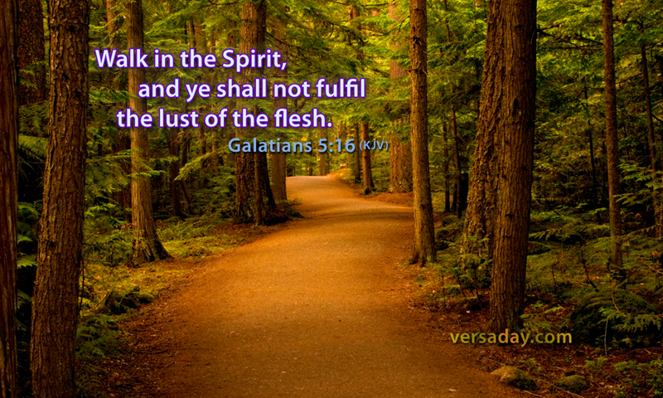
Galatians 5:16

Slide 22

Galatians 5:22-23

Slide 23
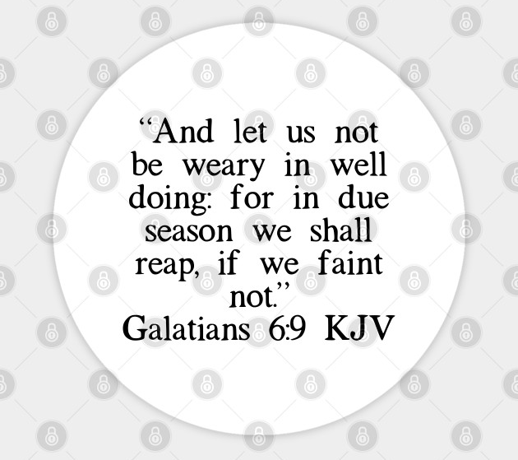
Galatians 6:9

Slide 24
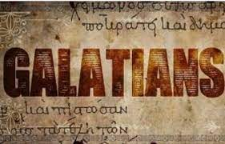

Slide 25
Galatians
The Judaizers in Galatia both discredited Paul and proclaimed a false gospel. It was necessary that Paul vindicate his apostleship and message, a task he undertook in the first two chapters. In this autobiographical section, Paul demonstrated convincingly that his apostleship and his message came by revelation from the risen Christ.
In chapters 3 and 4 Paul contended for the true doctrine of grace, that is, for justification by faith alone.
Finally, to show that Christian liberty does not mean license the apostle, in chapters 5 and 6, taught that a Christian should live by the power of the Holy Spirit and that when he does he manifests in his life not the works of the flesh but the fruit of the Spirit.

Slide 26
Galatians
The book of Galatians sparkles like a multifaceted gem. It has at least four sides that each brilliantly reflect a vital aspect of the truth and reveal the shortcomings of opposing views.
FIRST – it warns against abandoning the true gospel for a cheap imitation. After a brief greeting, Paul instantly dives into a veritable invective, calling down curses upon those who would tamper with the truth of the gospel (1:6-8). These aren’t the word of a raving lunatic or a dogmatic heresy hunter.
They reflect the passion of a patriot of grace who knows that adding to or taking from the one true gospel destroys the Christian faith itself.

Slide 27
Galatians
SECOND – it upholds the significance of grace. Except for the book of Romans, Paul’s letter to the Galatians presents the clearest and most succinct articulation of the doctrine of justification in Scripture.
Salvation comes by grace through faith apart from works. This simple truth stands as the bedrock of our faith. Remove this foundation of grace, and the whole building will crumble.

Slide 28
Galatians
THIRD – it presents the true function of the Mosaic Law. Obeying the Law of Moses can’t save us. In fact, it has never saved anyone. Never has, never will. Nobody (except Jesus) can ever keep the Law perfectly, although legalists like to pretend they can.
Paul acknowledges, however, that the Law serves a good and necessary purpose: It reveals our sin and need for grace, and it reminds us of God’s nonnegotiable standards of righteousness.

Slide 29
Galatians
FOURTH – it provides a needed balance so liberty is not abused. The gospel frees us from trying to earn or retain God’s favor through rule keeping, but it also keeps us from running headlong to the other extrem—willfully sinning in the name of freedom.
As people saved by grace, we have been sealed by the Spirit, who works in us to help us to love and obey Christ and to serve one another. We have been freed—not to do whatever we want, but to do what God wants.

Slide 30



Slide 31
NEXT CLASS – 26 Jan 2022
Book of Galatians
Before next class, read the below chapters in the KJV and in one other versions of the Bible, i.e., NKJV, NRSV, NIV, CEV, etc …
Chapter 1:1 – 10

Slide 32



the end
Questions
Questions

